Slide 1

Gym Management System
Team Members:
Krishna Tyagi
Shreya Gosrani
Sanket Khadke

Slide 2

Problem Statement
The main focus of the gym management system is that it automates the manual process of customer registration, selection as well as booking of workout slots as guided by the trainers present in the gym.
Apart from the choice of workout programs is done, the customer can freely book an inquiry slot with an existing trainer to get info on any topic.
The payment transaction part of any goods or products that the customer may purchase from the gym, as well as their shipping status is included.

Slide 3

Our Approach
In order to provide solution for the above problem, the proposed system will display a list of workout exercises which the customer can choose from. These workout programs are designed by the trainers available.
The trainers can add new program or remove an existing one as per their wish.
This system will keep track of the existing customers, the trainers and their managers, as well as all the sales records generated through customer transactions are maintained by the sales team.

Slide 4
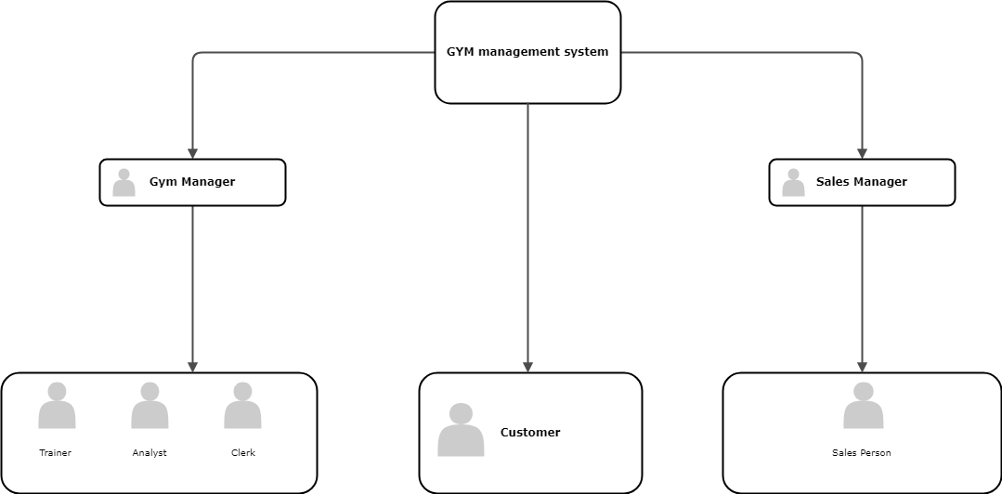
Hierarchy Structure

Slide 5
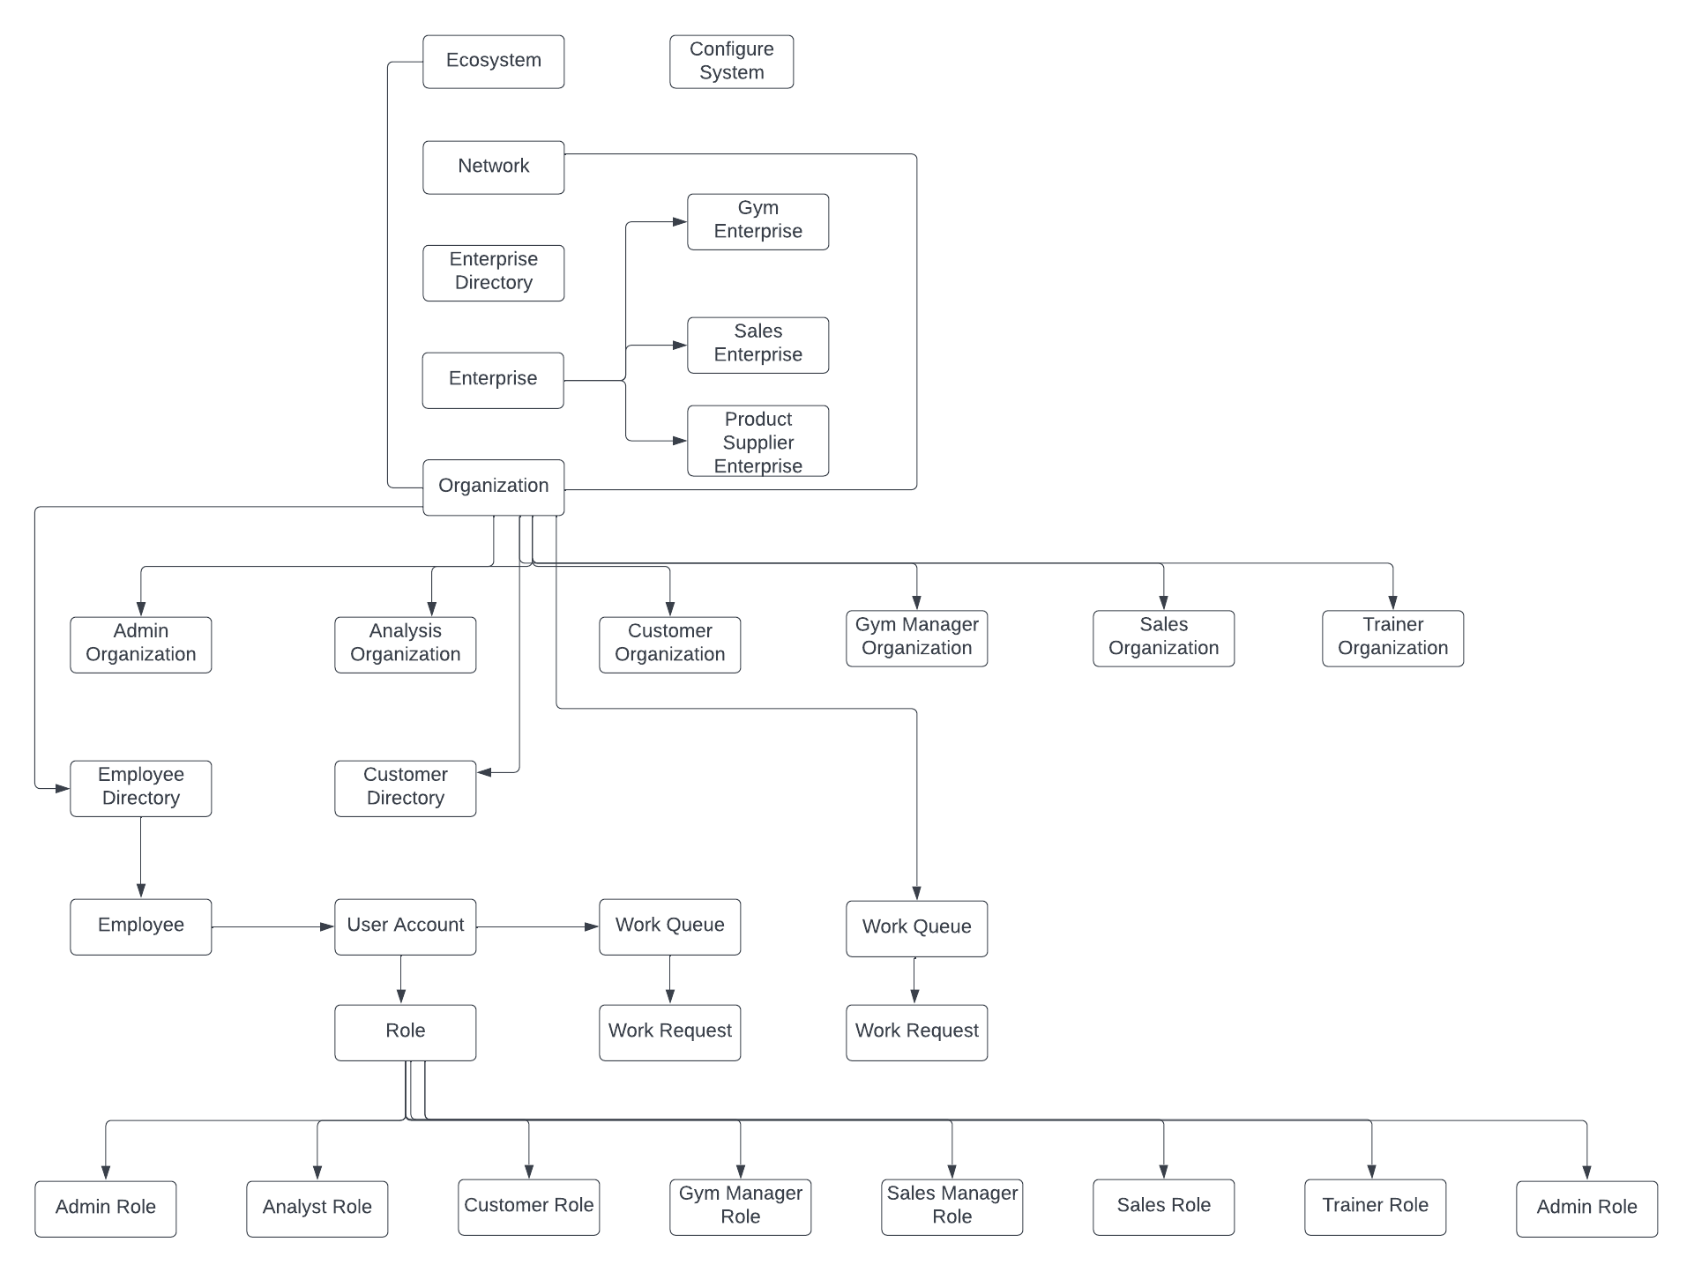
Architecture Diagram

Slide 6
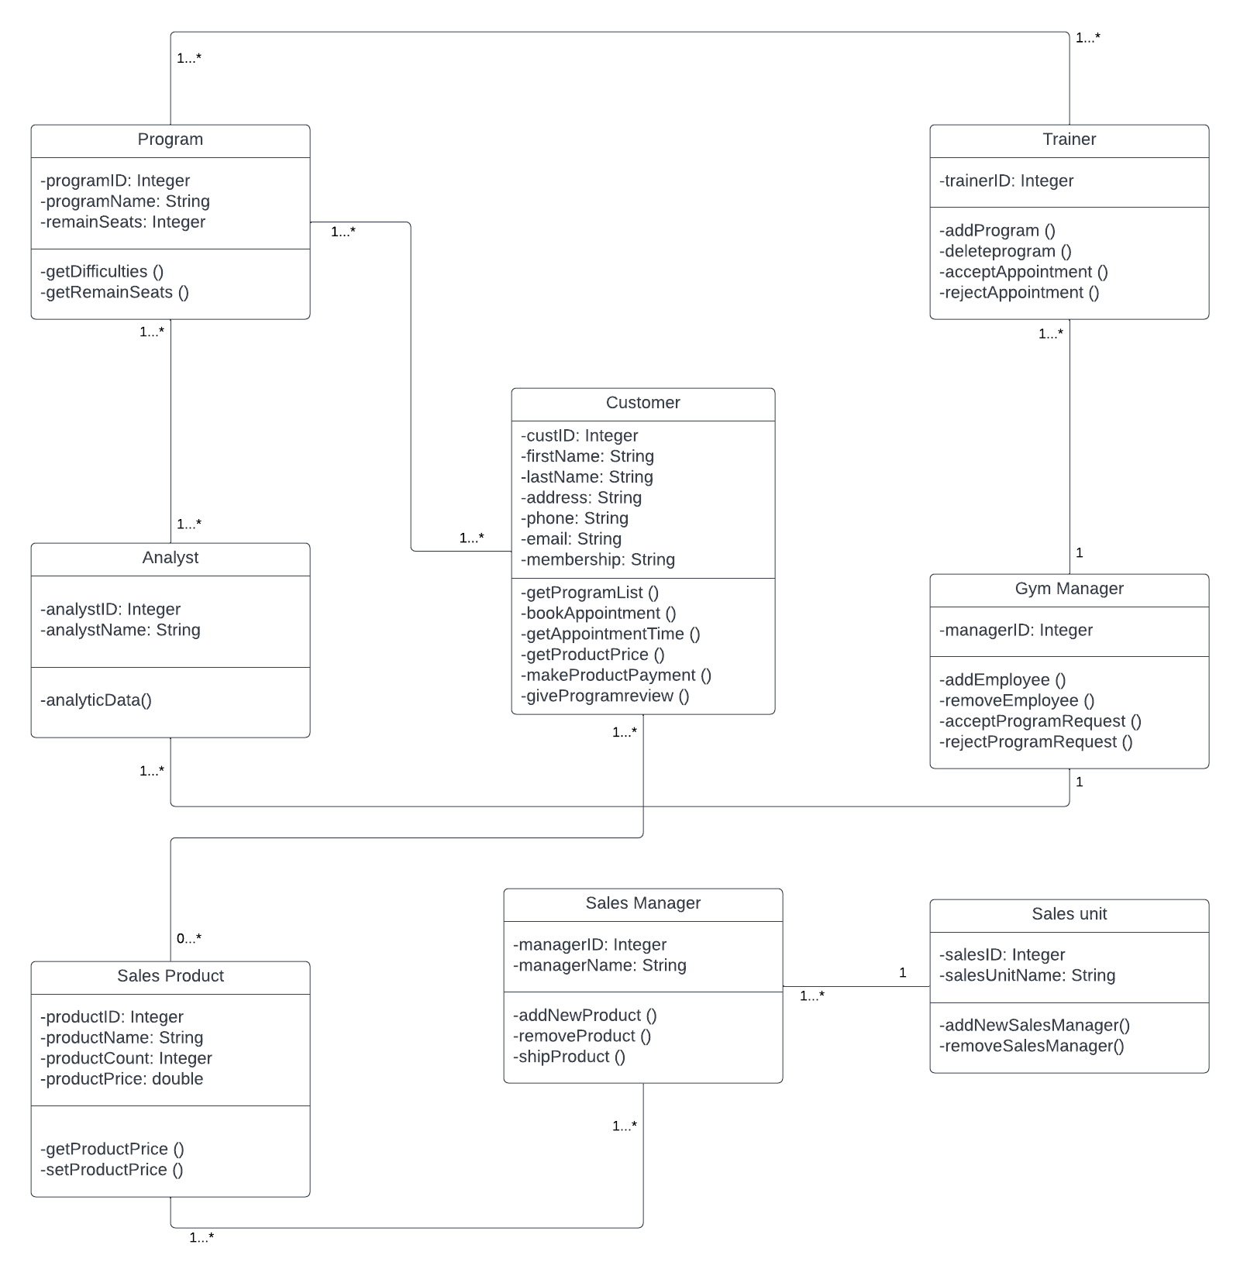
Class Diagram

Slide 7
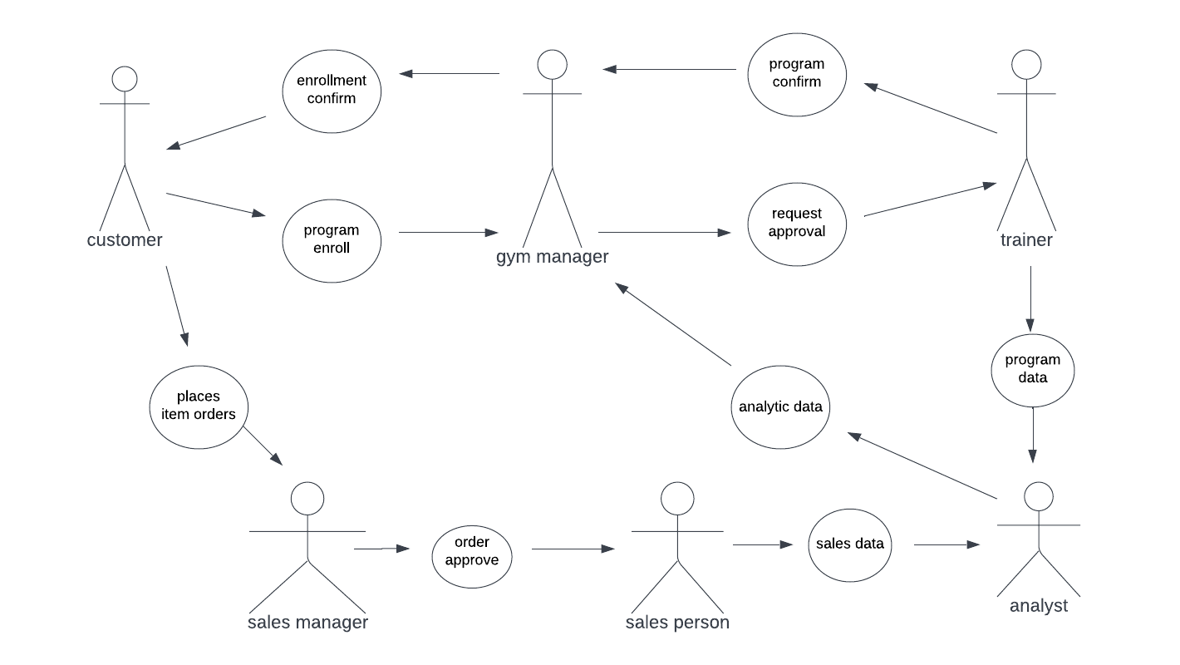
Use Case Diagram

Slide 8
User Interface Screens

Slide 9
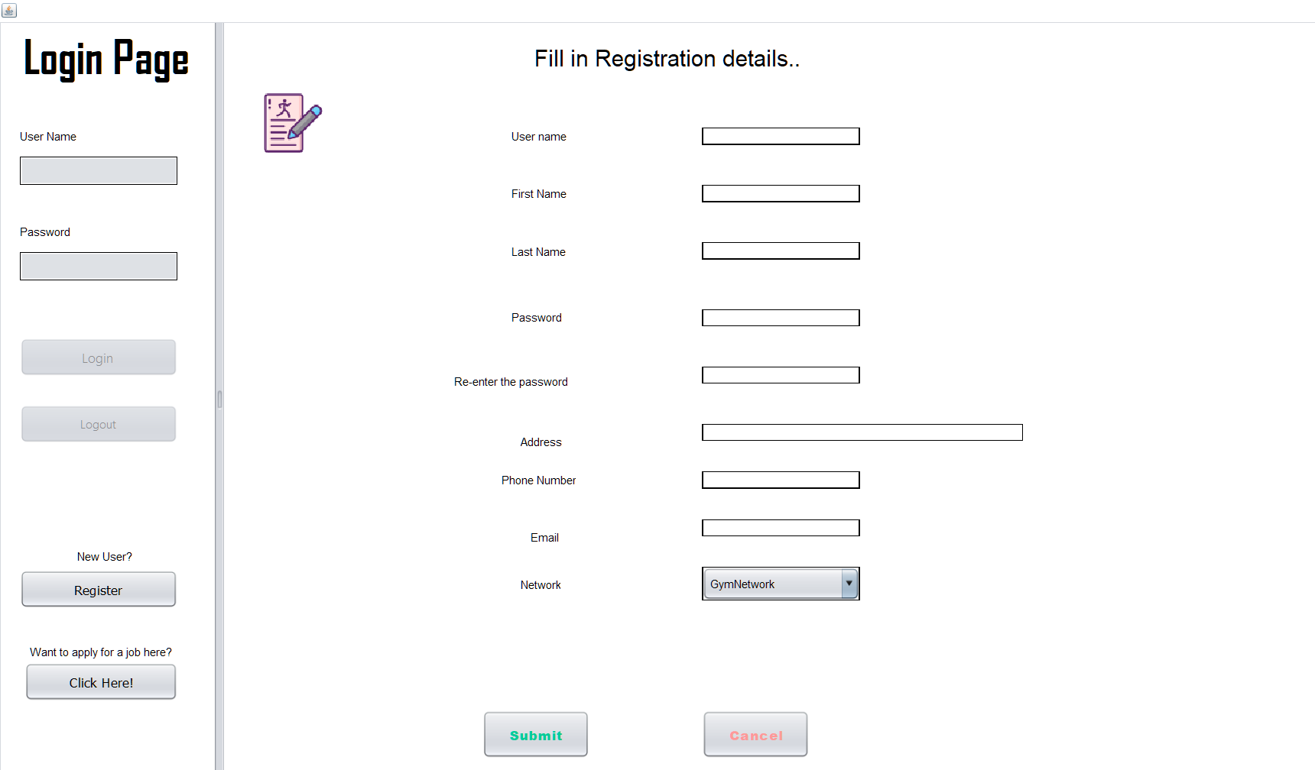
New customer on-boarding …

Slide 10
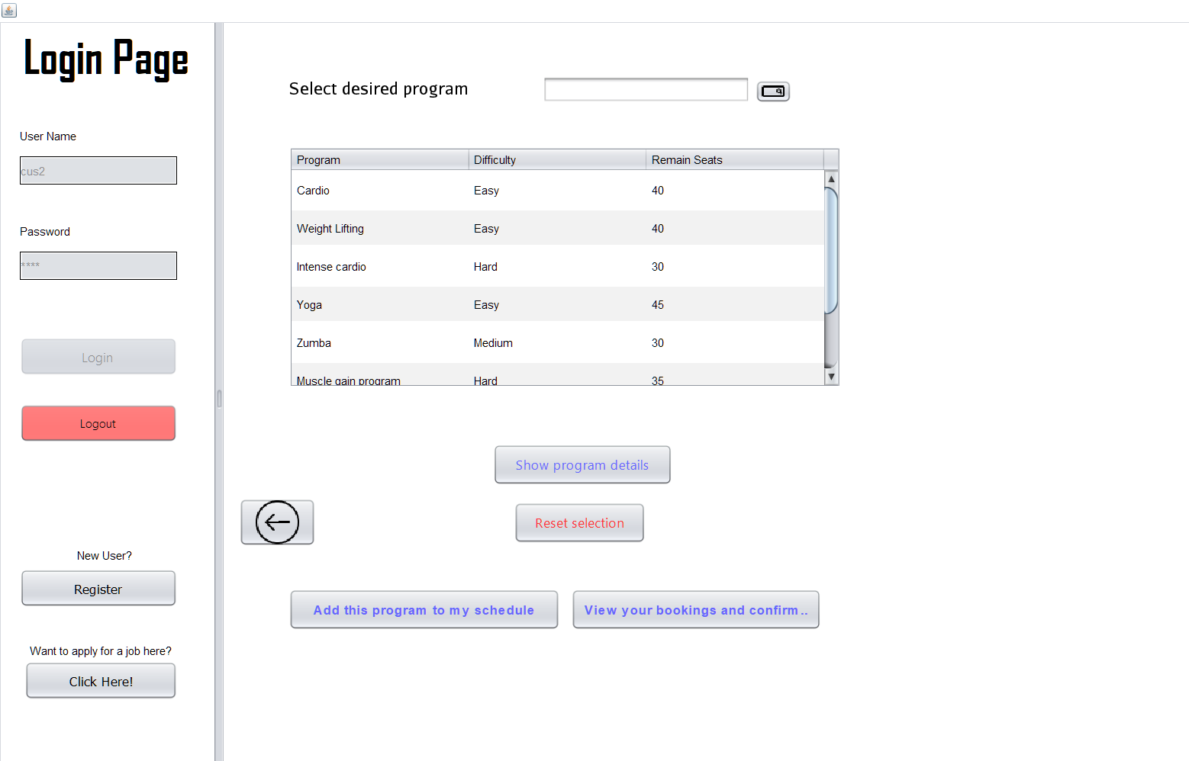
Customer selecting
workout program

Slide 11
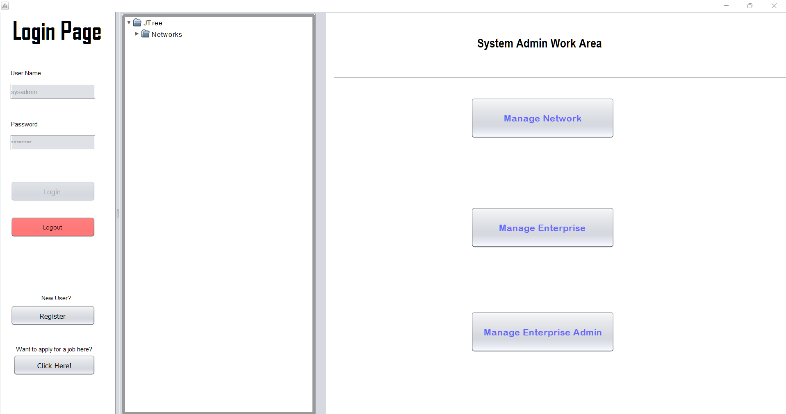
Admin Login

Slide 12
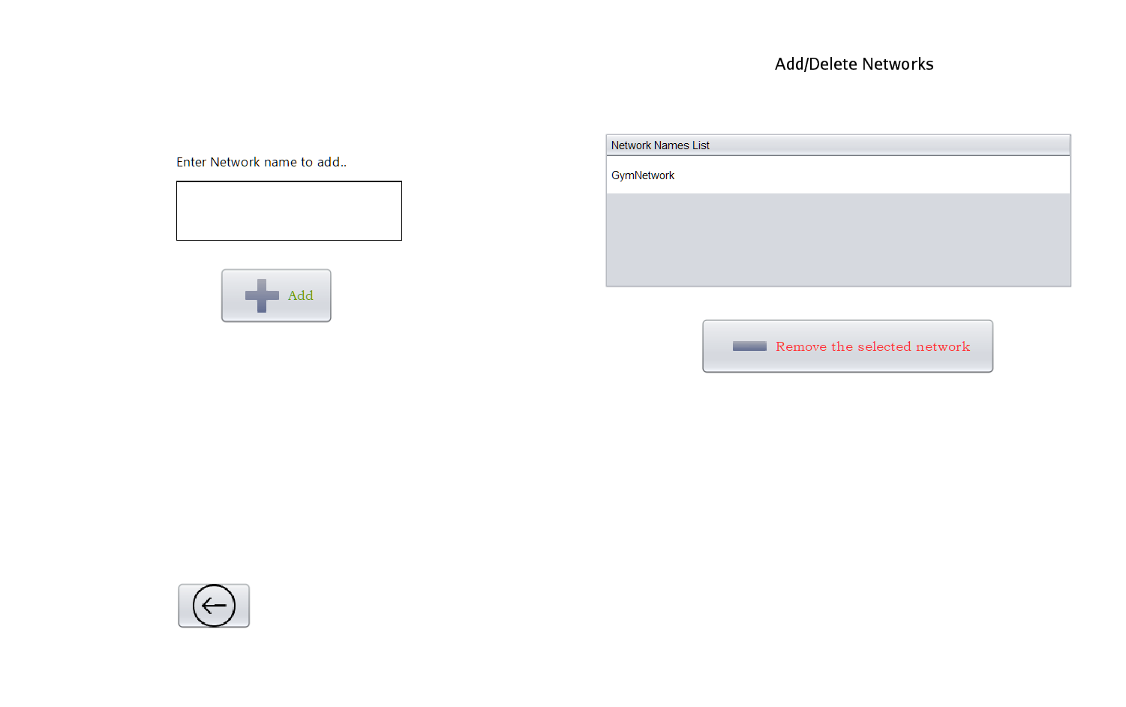
Adding new network…

Slide 13
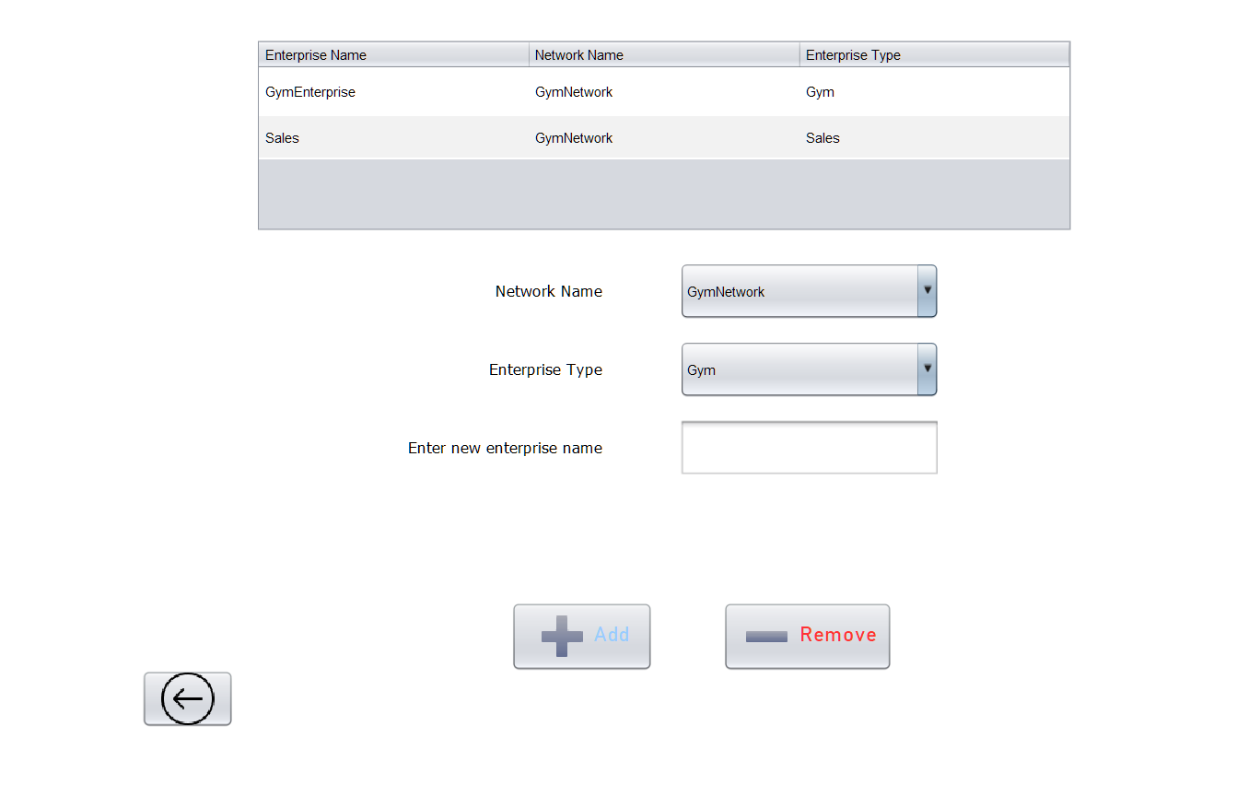
Adding new
enterprise…

Slide 14
Analysis Reports …

Slide 15
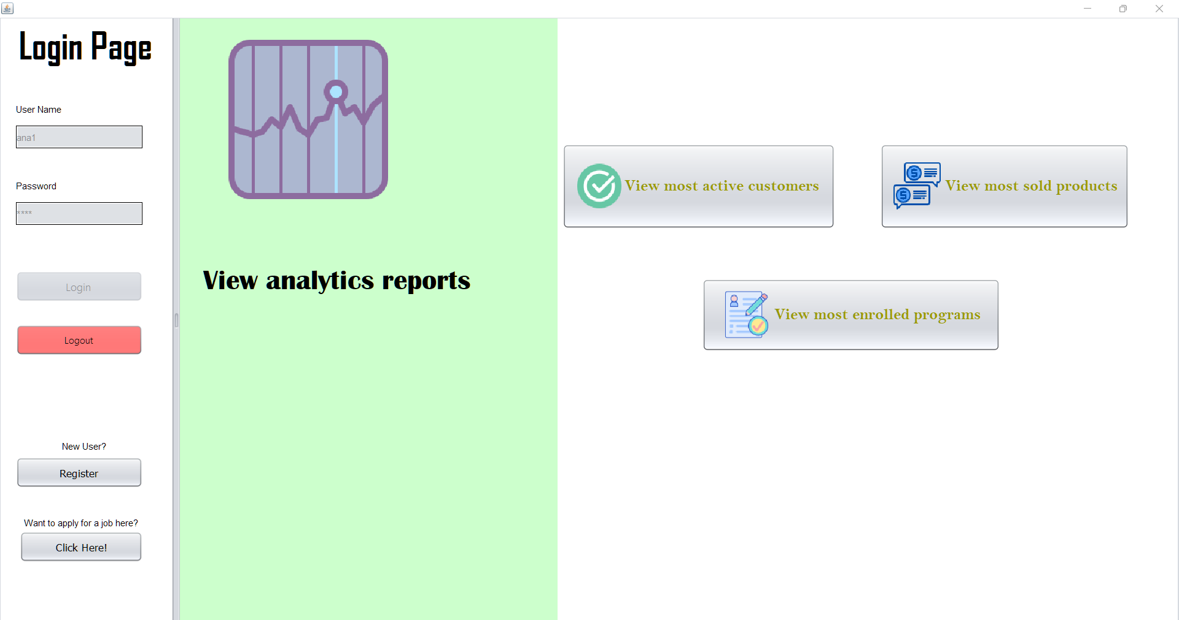

Slide 16


